Slide 1
BEAR
COMFORTABLE FIT - DISCREET PACKAGING - ALWAYS READY
PRESENTED BY
FRANCISCO ANDRADE

Slide 2
A NORDIC
CONDOM COMPANY
Nordic minimalism.
Swedish safety.
Stockholm chique.

Slide 3
A FAMILY
COMPANY
Created by 4 cousins.
Seeing a gap in the market for a stylish quality condom.
By women, for men.

Slide 4
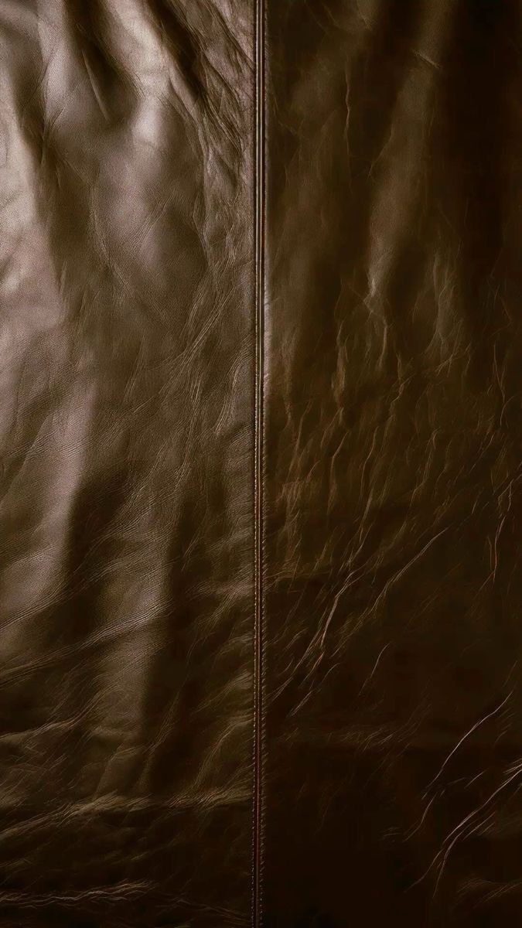
COMFORTABLE FIT
We have tested all different types and shapes so you don’t have to.
Quality materials.
Shape that fits all.
A condom that feels like its barely there.

Slide 5
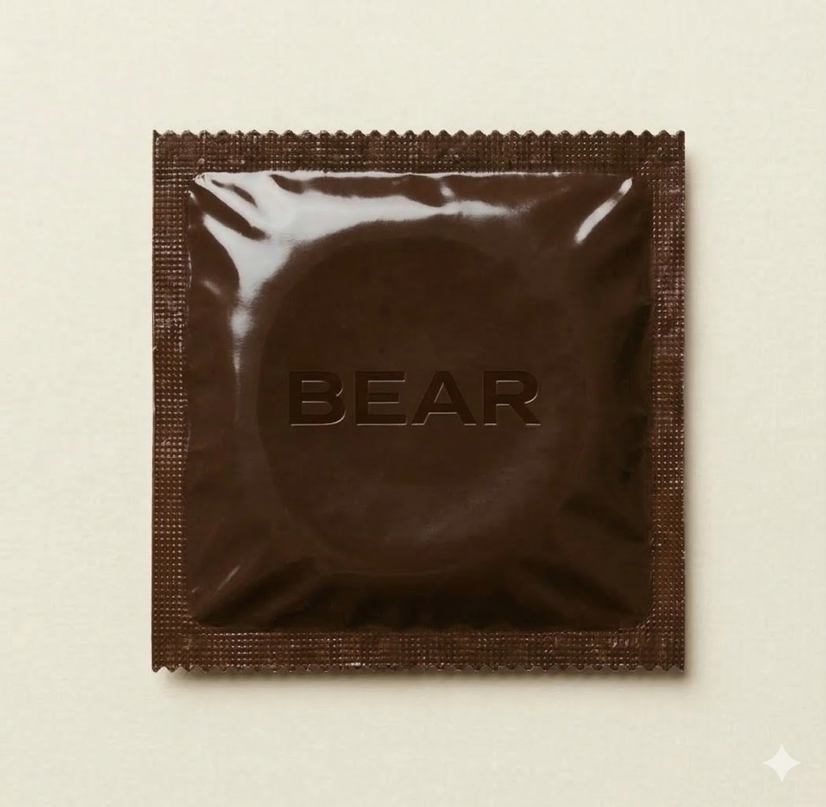
DISCREET
PACKAGING
BEAR BROWN - discreet , minimalistic and stylish.
Innovative packaging for every occasion.

Slide 6

ON THE GO (4) - BRING ON AN ADVENTURE (12) - STOCK UP AT HOME (36)

Slide 7

ON THE GO (4) - BRING ON AN ADVENTURE (12) - STOCK UP AT HOME (36)

Slide 8
SUBSCRIPTION
Easily made available from one click on our website.
After you subsribe you will always have a condom available.
Pause the subscription at any time.
As we say in the Swedishs scout core: ALLTID REDO!

Slide 9
JOIN OUR JOURNEY
INSTAGRAM
FACEBOOK
TIKTOK

Slide 10
COMING SOON

